Slide 1





Course Name object oriented analysis and design
CSC 2210
(Undergraduate)
Software engineering (Undergraduate)
Chapter 10 design pattern
M. Mahmudul hasan
Assistant Professor, CS, AIUB
http://www.dit.hua.gr/~m.hasan

Slide 2
What is design pattern?
S.2
MMH
A design pattern describes a problem that occurs over and over in software engineering
And then describes the solution in a sufficiently generic manner as to be applicable in a wide variety of contexts.

Slide 3
Typical pattern format
S.3
MMH
The pattern name
The problem
Specification of the problem
Explanation why it is important
Applications
Examples of known uses

Slide 4
Software measurement
S.4
MMH
The solution
A description of classes possibly with a structure diagram
A language independent implementation, with language-specific issues as appropriate
Sample code
Consequences
Results
Trade-offs of using the pattern
A discussion of related patterns

Slide 5
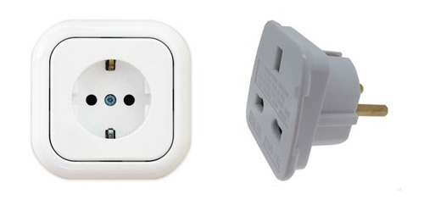
adapter
S.5
MMH
An adapter is used when you need to use an existing class, but its interface is not the one you need
An adapter changes an interface into one that a client expects.
“Putting a Square Plug in a Round Socket”
Implementing an adapter may require little work or a great deal of work depending on the size and complexity of the target interface.
An adapter wraps an object to change its interface, a decorator wraps an object to add new behaviors and responsibilities.

Slide 6
adapter
S.6
MMH
Scenario: you have an existing software system that you need to work a new vendor library into it, but the new vendor designed their interfaces differently than the last vendor
What to do?
Write a class that adapts the new vendor interface into the one you’re expecting
Your Existing
System
Vendor
Class
Their interface doesn’t match the one you’ve written your code against. Not going to work!
Your Existing
System
Vendor
Class
Adapter
No code changes
New code
No code changes

Slide 7
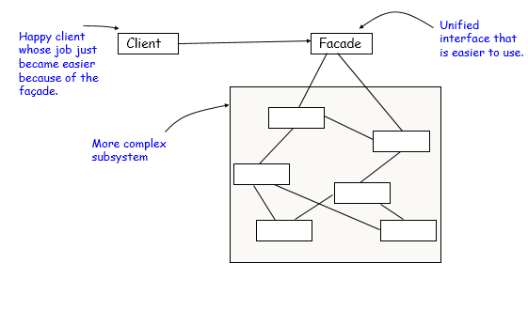
FAÇADE
S.7
MMH
A façade is used when you need to simplify and unify a large interface or a complex set of interfaces
The Façade Pattern provides a unified interface to a set of interfaces in a subsystem. Façade defines a higher-level interface that makes the subsystem easier to use
A façade decouples the client from a complex subsystem
Implementing a façade requires that we compose the façade with its subsystem and use delegation to perform the work of the façade
A façade “wraps” a set of objects to simplify
This pattern hides all the complexity behind

Slide 8
observer
S.8
MMH
Observer pattern is used when there is one-to-many relationship between objects such as if one object is modified, its dependent objects are to be notified automatically
Example: when you subscribe to your local newspaper agent, every time there is a new edition, it gets delivered to you
It is mainly used to implement distributed event handling systems

Slide 9
singleton
S.9
MMH
The Singleton pattern ensures you have at most one instance of a class in your application (One of a Kind Objects)
For example, in a system there should be only one window manager (or only a file system or only a print spooler)
If more than one instantiated: Incorrect program behavior, overuse of resources, inconsistent results

Slide 10
Strategy
S.10
MMH
Strategy pattern allows selection of one of several algorithms dynamically
In Strategy pattern, a class behavior or its algorithm can be changed at run time.
Strategies don’t hide everything -- client code is typically aware that there are a number of strategies and has some criteria to choose among them -- shifts the algorithm decision to the client.
In Strategy pattern, we create objects which represent various strategies and a context object whose behavior varies as per its strategy object. The strategy object changes the executing algorithm of the context object.

Slide 11
factory
MMH
S.11
When a method returns one of several possible classes that share a common super class
Class is chosen at run time
Factory pattern allows to create objects without specifying the exact class of object that will be created

Slide 12
references
MMH
R.S. Pressman & Associates, Inc (2010). Software Engineering: A Practitioner’s Approach.

